Slide 1
TCP/IP and UDP - Parshu Ram Sharma

Slide 2
TCP/IP
The TCP/IP model was developed prior to the OSI model.
The TCP/IP model is not exactly similar to the OSI model.
The TCP/IP model consists of five layers: the application layer, transport layer, network layer, data link layer and physical layer.
The first four layers provide physical standards, network interface, internetworking, and transport functions that correspond to the first four layers of the OSI model and these four layers are represented in TCP/IP model by a single layer called the application layer.
TCP/IP is a hierarchical protocol made up of interactive modules, and each of them provides specific functionality.

Slide 3
Features
TCP is reliable protocol. That is, the receiver always sends either positive or negative acknowledgement about the data packet to the sender, so that the sender always has bright clue about whether the data packet is reached the destination or it needs to resend it.
TCP ensures that the data reaches intended destination in the same order it was sent.
TCP is connection oriented. TCP requires that connection between two remote points be established before sending actual data.
TCP provides error-checking and recovery mechanism.
TCP provides end-to-end communication.
TCP provides flow control and quality of service.
TCP operates in Client/Server point-to-point mode.
TCP provides full duplex server, i.e. it can perform roles of both receiver and sender.

Slide 4
UDP
The User Datagram Protocol (UDP) is simplest Transport Layer communication protocol available of the TCP/IP protocol suite. It involves minimum amount of communication mechanism. UDP is said to be an unreliable transport protocol but it uses IP services which provides best effort delivery mechanism.
In UDP, the receiver does not generate an acknowledgement of packet received and in turn, the sender does not wait for any acknowledgement of packet sent. This shortcoming makes this protocol unreliable as well as easier on processing.

Slide 5
Features
UDP is used when acknowledgement of data does not hold any significance.
UDP is good protocol for data flowing in one direction.
UDP is simple and suitable for query-based communications.
UDP is not connection oriented.
UDP does not provide congestion control mechanism.
UDP does not guarantee ordered delivery of data.
UDP is stateless.
UDP is suitable protocol for streaming applications such as VoIP, multimedia streaming.

Slide 6
UDP application
Here are few applications where UDP is used to transmit data:
Domain Name Services
Simple Network Management Protocol
Trivial File Transfer Protocol
Routing Information Protocol
Kerberos

Slide 7
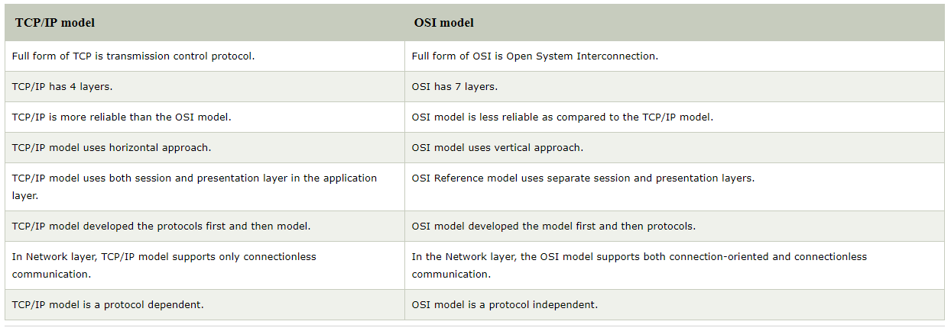

Slide 8
TCP/IP model | OSI model
Full form of TCP is transmission control protocol. | Full form of OSI is Open System Interconnection.
TCP/IP has 4 layers. | OSI has 7 layers.
TCP/IP is more reliable than the OSI model. | OSI model is less reliable as compared to the TCP/IP model.
TCP/IP model uses horizontal approach. | OSI model uses vertical approach.
TCP/IP model uses both session and presentation layer in the application layer. | OSI Reference model uses separate session and presentation layers.
TCP/IP model developed the protocols first and then model. | OSI model developed the model first and then protocols.
In Network layer, TCP/IP model supports only connectionless communication. | In the Network layer, the OSI model supports both connection-oriented and connectionless communication.
TCP/IP model is a protocol dependent. | OSI model is a protocol independent.

Slide 9
Following are the protocols used in internet layer are:
IP Protocol
IP protocol is used in this layer, and it is the most significant part of the entire TCP/IP suite.
Following are the responsibilities of this protocol:
IP Addressing: This protocol implements logical host addresses known as IP addresses. The IP addresses are used by the internet and higher layers to identify the device and to provide internetwork routing.
Host-to-host communication: It determines the path through which the data is to be transmitted.
Data Encapsulation and Formatting: An IP protocol accepts the data from the transport layer protocol. An IP protocol ensures that the data is sent and received securely, it encapsulates the data into message known as IP datagram.
Cont…

Slide 10
Fragmentation and Reassembly: The limit imposed on the size of the IP datagram by data link layer protocol is known as Maximum Transmission unit (MTU). If the size of IP datagram is greater than the MTU unit, then the IP protocol splits the datagram into smaller units so that they can travel over the local network. Fragmentation can be done by the sender or intermediate router. At the receiver side, all the fragments are reassembled to form an original message.
Routing: When IP datagram is sent over the same local network such as LAN, MAN, WAN, it is known as direct delivery. When source and destination are on the distant network, then the IP datagram is sent indirectly. This can be accomplished by routing the IP datagram through various devices such as routers.

Slide 11
ARP Protocol
ARP stands for Address Resolution Protocol.
ARP is a network layer protocol which is used to find the physical address from the IP address.
The two terms are mainly associated with the ARP Protocol:
ARP request: When a sender wants to know the physical address of the device, it broadcasts the ARP request to the network.
ARP reply: Every device attached to the network will accept the ARP request and process the request, but only recipient recognize the IP address and sends back its physical address in the form of ARP reply. The recipient adds the physical address both to its cache memory and to the datagram header

Slide 12
ICMP Protocol
ICMP stands for Internet Control Message Protocol.
It is a mechanism used by the hosts or routers to send notifications regarding datagram problems back to the sender.
A datagram travels from router-to-router until it reaches its destination. If a router is unable to route the data because of some unusual conditions such as disabled links, a device is on fire or network congestion, then the ICMP protocol is used to inform the sender that the datagram is undeliverable.
Cont…

Slide 13
An ICMP protocol mainly uses two terms:
ICMP Test: ICMP Test is used to test whether the destination is reachable or not.
ICMP Reply: ICMP Reply is used to check whether the destination device is responding or not.
The core responsibility of the ICMP protocol is to report the problems, not correct them. The responsibility of the correction lies with the sender.
ICMP can send the messages only to the source, but not to the intermediate routers because the IP datagram carries the addresses of the source and destination but not of the router that it is passed to.

Slide 14
Useful Link for DCN
https://www.tutorialspoint.com/data_communication_computer_network/transmission_control_protocol.htm
https://www.javatpoint.com/computer-network-tcp-ip-model

